Slide 1
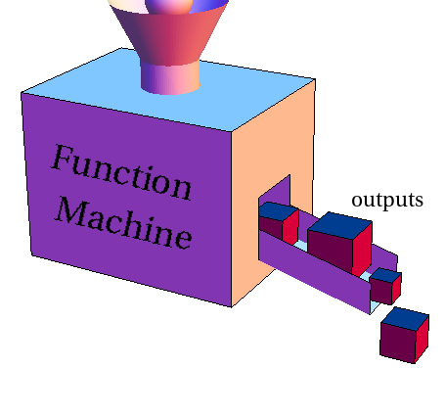
Hashing and one way functions

Slide 2
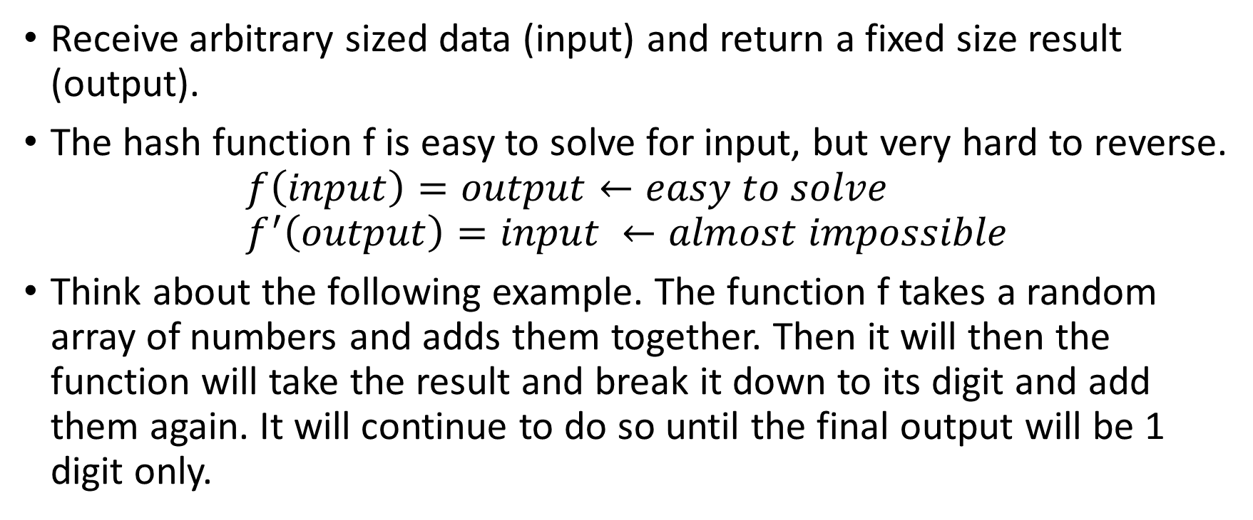
Hash function
Receive arbitrary sized data (input) and return a fixed size result (output).
The hash function f is easy to solve for input, but very hard to reverse.
$$f\left(input\right)=output←easy to solve \\ f^{′}\left(output\right)=input ←almost impossible$$
Think about the following example. The function f takes a random array of numbers and adds them together. Then it will then the function will take the result and break it down to its digit and add them again. It will continue to do so until the final output will be 1 digit only.
Notes:
([1, 7, 9, 7, 9, 2]) 1+7+9+7+9+2 = 35
3, 5 = 3+8=8

Slide 3


For every input (x) hash function will always return the same output (y)
To prevent the creation of Rainbow tables, many applications that uses hash function also adds nonce to their input.
Message to hash
$$f$$
Result
Message to hash
Nonce
$$f$$
Different result
SHA256
RIPEMD160
Bitcoin mostly uses 2 hashing functions

Slide 4
Hashing messages to find their checksum.
Hashing transaction to find their id number.
Hashing transaction together (merkle roots).
Hashing blocks to find their header.
Hashing public keys both the get hashed public key (which is used to validate transactions) and is required to create a valid bitcoin address.

